Slide 1
Update Xenxible Project Device Identifier
Syaziyah

Slide 2
MACHINE LEARNING PIPELINE
INPUT
(Customer, Project, Device ID)
CREATE ON (18.03.2026)
UPDATE ON (20.0.2026)
NEW LIST EQUIPMENT
ML MODEL
UPDATE & SAVE MODEL
PREFIX
SUFFIX
SGD Classifier Hybrid Model
- SGD Classifier
- Composite Similarity
XGBoost
DBScan
Device Type
Section
Cluster
UNKNOWN
= Assign by User
RESULT OUTPUT
(Customer, Project, Device ID, Device Type, Section)
UPDATE & SAVE MODEL

Slide 3
MACHINE LEARNING PIPELINE
INPUT
(Customer, Project, Device ID)
UPDATE ON (16.04.2026)
1
ML MODEL
RETRIVE
[new_equipment.pkl]
SGD Classifier
XGBoost
NEW LIST OF EQUIPMENT
3
Data type
Cluster
Section
UNKNOWN
= Assign by User
RESULT OUTPUT
(Customer, Project, Device ID, Section, Cluster)
2
Process flow
(1) Input - Model – Result Output – Update & Save Model
(2) Input - Model - Output (UNKNOWN) - Assign by user – New Equipment Data
- Model – Update & Save Model
(3) New Equipment Data - Model - Update & Save Model
UPDATE & SAVE MODEL

Slide 4
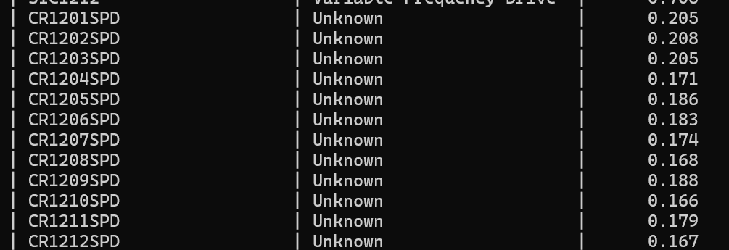
Source Project A1825 - LIPICO : CR___SPD refer to Control Valve/VSD.
But for CR refer to agitator. Hence the model unable to captured what is the right device type for this

Slide 5
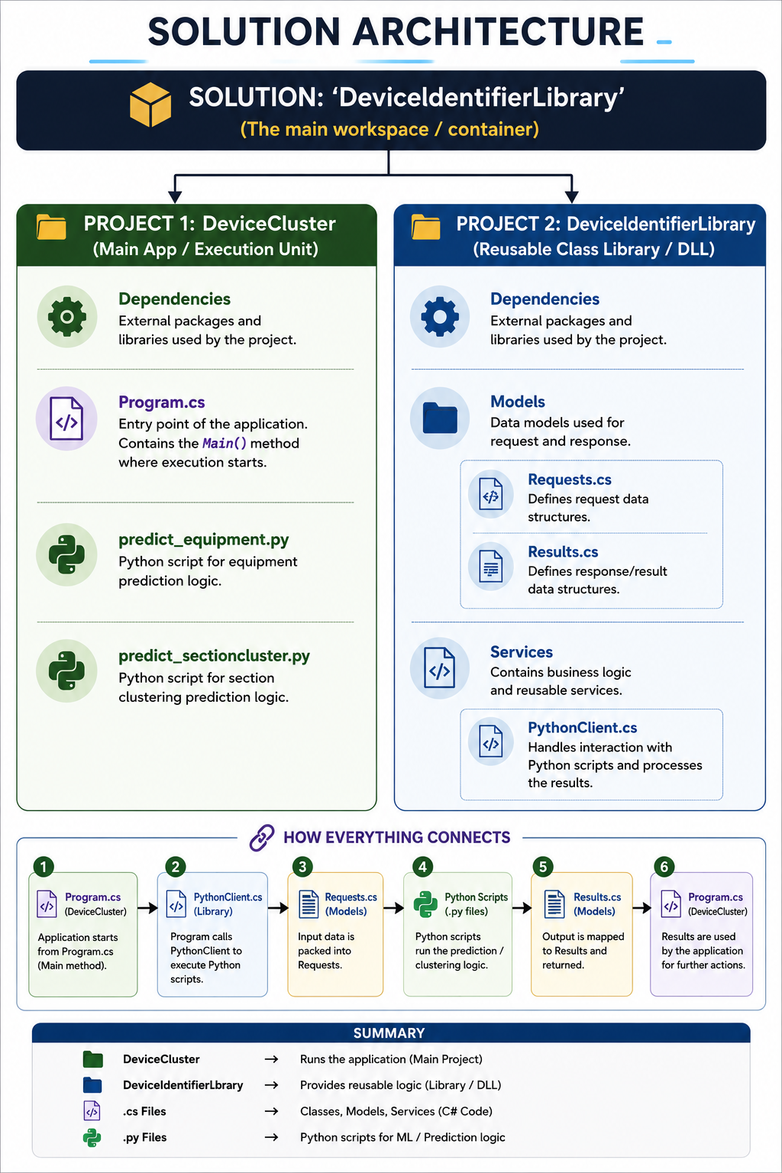
HOW TO SORT THE PROJECT?

